Slide 1
Associative-Memory Networks
Input: Pattern (often noisy/corrupted)
Output: Corresponding pattern (complete / relatively noise-free)
Process
  Load input pattern onto core group of highly-interconnected neurons.
  Run core neurons until they reach a steady state.
  Read output off of the states of the core neurons.
Inputs
Outputs
Input: (1 0 1 -1 -1)
Output: (1 -1 1 -1 -1)

Slide 2
Associative Network Types
1. Auto-associative: X = Y
*Recognize noisy versions of a pattern
2. Hetero-associative Bidirectional: X <> Y
BAM = Bidirectional Associative Memory
*Iterative correction of input and output

Slide 3
Associative Network Types (2)
3. Hetero-associative Input Correcting: X <> Y
*Input clique is auto-associative => repairs input patterns
4. Hetero-associative Output Correcting: X <> Y
*Output clique is auto-associative => repairs output patterns

Slide 4
Hebb’s Rule
Connection Weights ~ Correlations
``When one cell repeatedly assists in firing another, the axon of the first cell
develops synaptic knobs (or enlarges them if they already exist) in contact
with the soma of the second cell.” (Hebb, 1949)
In an associative neural net, if we compare two pattern components (e.g. pixels)
within many patterns and find that they are frequently in:
a) the same state, then the arc weight between their NN nodes should be positive
b) different states, then ” ” ” ” negative
Matrix Memory:
The weights must store the average correlations between all pattern components
across all patterns. A net presented with a partial pattern can then use the correlations
to recreate the entire pattern.

Slide 5
Correlated Field Components
Each component is a small portion of the pattern field (e.g. a pixel).
In the associative neural network, each node represents one field component.
For every pair of components, their values are compared in each of several patterns.
Set weight on arc between the NN nodes for the 2 components ~ avg correlation.
a
a
??
??
b
b
Avg Correlation
w_{ab}
a
b

Slide 6
Quantifying Hebb’s Rule
Compare two nodes to calc a weight change that reflects the state correlation:
Auto-Association:
* When the two components are the same (different),
increase (decrease) the weight
i = input component
o = output component
Hetero-Association:
Ideally, the weights will record the average correlations across all patterns:
Auto:
Hetero:
Hebbian Principle: If all the input patterns are known prior to retrieval time,
then init weights as:
Auto:
Hetero:
Weights = Average Correlations

Slide 7
Matrix Representation
Let X = matrix of input patterns, where each ROW is a pattern. So x_{k,i} = the ith bit of the kth pattern.
Let Y = matrix of output patterns, where each ROW is a pattern. So y_{k,j} = the jth bit of the kth pattern.
Then, avg correlation between input bit i and output bit j across all patterns is:
1/P (x_{1,i}y_{1,j} + x_{2,i}y_{2,j} + … + x_{p,i}y_{p,j}) = w_{i,j}
To calculate all weights:
Hetero Assoc: W = X^{T}Y
Auto Assoc: W = X^{T}X
X
X^{T}
Dot product
Y
P1 P2 Pp
X_{1,i}
X_{2,i}
X_{p,i}
Out P1: y_{1,1}.. y_{1,j}……y_{1,n}
In Pattern 1: x_{1,1}..x_{1,n}
..
Out P2: y_{2,1}.. y_{2,j}……y_{2,n}
In Pattern 2: x_{2,1}..x_{2,n}
:
:
Out P3: y_{p,1}.. y_{p,j} ……y_{p,n}
In Pattern p: x_{1,1}..x_{1,n}

Slide 8
Auto-Associative Memory
1. Auto-Associative Patterns to Remember
3. Retrieval
Comp/Node value legend:
dark (blue) with x => +1
dark (red) w/o x => -1
light (green) => 0
1
2
1
2
1
2
3
4
3
4
3
4
2. Distributed Storage of All Patterns:
1
2
1
2
3
4
-1
1
1
2
3
4
3
4
1 node per pattern unit
Fully connected: clique
Weights = avg correlations across
all patterns of the corresponding units
1
2
3
4

Slide 9
Hetero-Associative Memory
1. Hetero-Associative Patterns (Pairs) to Remember
3. Retrieval
1
1
a
a
2
2
b
b
3
3
2. Distributed Storage of All Patterns:
1
-1
a
1
2
b
3
1 node per pattern unit for X & Y
Full inter-layer connection
Weights = avg correlations across
all patterns of the corresponding units

Slide 10
Hopfield Networks
Auto-Association Network
Fully-connected (clique) with symmetric weights
State of node = f(inputs)
Weight values based on Hebbian principle
Performance: Must iterate a bit to converge on a pattern, but generally
much less computation than in back-propagation networks.
Input
Output (after many iterations)
Discrete node update rule:
Input value

Slide 11
Hopfield Network Example
1. Patterns to Remember
3. Build Network
p₁
p₂
p₃
1/3
1
2
1
2
1
2
1
2
1/3
[-]
3
4
3
4
3
4
-1/3
-1/3
[+]
1/3
3
4
2. Hebbian Weight Init:
Avg Correlations across 3 patterns
-1
p₁
p₂
p₃
Avg
4. Enter Test Pattern
W₁₂ 1 1 -1 1/3
1/3
W₁₃ 1 -1 -1 -1/3
1
2
1/3
W₁₄ -1 1 1 1/3
-1/3
-1/3
3
4
1/3
W₂₃ 1 -1 1 1/3
W₂₄ -1 1 -1 -1/3
-1
+1
0
-1
W₃₄ -1 -1 -1 -1

Slide 12
Hopfield Network Example (2)
5. Synchronous Iteration (update all nodes at once)
Inputs
From discrete output rule: sign(sum)
Node 1 2 3 4 Output
1 1 0 0 -1/3 1
2 1/3 0 0 1/3 1
3 -1/3 0 0 1 1
4 1/3 0 0 -1 -1
Values from Input Layer
1/3
p₁
1/3
=
-1/3
1
2
-1/3
1/3
3
4
-1
Stable State

Slide 13
Using Matrices
Goal: Set weights such that an input vector Vi, yields itself when multiplied by the weights, W.
X = V1,V2..Vp, where p = # input vectors (i.e., patterns)
So Y=X, and the Hebbian weight calculation is: W = X^{T}Y = X^{T}X
1 1 -1
1 1 1 -1 1 1 1
X = 1 1 -1 1 X^{T}= 1 -1 1
-1 1 1 -1 -1 1 -1
3 1 -1 1 Common index = pattern #, so
X^{T}X = 1 3 1 -1 this is correlation sum.
-1 1 3 -3
1 -1 -3 3
w_{2,4} = w_{4,2} = x^{T}_{2,1}x_{1,4} + x^{T}_{2,2}x_{2,4} + x^{T}_{2,3}x_{3,4}

Slide 14
Matrices (2)
The upper and lower triangles of the product matrix represents the 6 weights w_{i,j} = w_{j,i}
Scale the weights by dividing by p (i.e., averaging) . Picton (ANN book) subtracts p from each. Either method is fine, as long we apply the appropriate thresholds to the output values.
This produces the same weights as in the non-matrix description.
Testing with input = ( 1 0 0 -1)
  3 1 -1 1 (1 0 0 -1) 1 3 1 -1 = (2 2 2 -2)
  -1 1 3 -3
1 -1 -3 3
Scaling* by p = 3 and using 0 as a threshold gives:
(2/3 2/3 2/3 -2/3) => (1 1 1 -1)
*For illustrative purposes, it’s easier to scale by p at the end instead of scaling the entire weight matrix, W, prior to testing.

Slide 15
Hopfield Network Example (3)
4b. Enter Another Test Pattern
1/3
Spurious Outputs
1
2
1/3
Input pattern is stable,
but not one of the
original patterns.
Attractors in node-state
space can be whole
patterns, parts of
patterns, or other
combinations.
-1/3
-1/3
3
4
1/3
-1
5b. Synchronous Iteration
Inputs
Node 1 2 3 4 Output
1 1 1/3 0 0 1
2 1/3 1 0 0 1
3 -1/3 1/3 0 0 0
4 1/3 -1/3 0 0 0

Slide 16
Hopfield Network Example (4)
4c. Enter Another Test Pattern
1/3
1
2
1/3
-1/3
-1/3
Asynchronous Updating is central
to Hopfield’s (1982) original model.
3
4
1/3
-1
5c. Asynchronous Iteration (One randomly-chosen node at a time)
Update 3
Update 4
Update 2
Stable &
Spurious
1/3
1/3
1/3
1/3
1/3
1/3
-1/3
-1/3
-1/3
-1/3
-1/3
-1/3
1/3
1/3
1/3
-1
-1
-1

Slide 17
Hopfield Network Example (5)
4d. Enter Another Test Pattern
1/3
1
2
1/3
-1/3
-1/3
3
4
1/3
-1
5d. Asynchronous Iteration
Update 3
Update 4
Update 2
Stable
Pattern
p₃
1/3
1/3
1/3
1/3
1/3
1/3
-1/3
-1/3
-1/3
-1/3
-1/3
-1/3
1/3
1/3
1/3
-1
-1
-1

Slide 18
Hopfield Network Example (6)
4e. Enter Same Test Pattern
1/3
1
2
1/3
-1/3
-1/3
3
4
1/3
-1
5e. Asynchronous Iteration (but in different order)
Update 2
Update 3 or 4 (No change)
1/3
1/3
1/3
1/3
Stable &
Spurious
-1/3
-1/3
-1/3
-1/3
1/3
1/3
-1
-1

Slide 19
Associative Retrieval = Search
p₃
p₁
p₂
Back-propagation:
Search in space of weight vectors to minimize output error
Associative Memory Retrieval:
Search in space of node values to minimize conflicts between a) node-value pairs
and average correlations (weights), and b) node values and their initial values.
Input patterns are local (sometimes global) minima, but many
spurious patterns are also minima.
High dependence upon initial pattern and update sequence (if asynchronous)

Slide 20
Storage Capacity of Hopfield Networks
Capacity = Relationship between # patterns that can be stored & retrieved
without error to the size of the network.
Capacity = # patterns / # nodes or # patterns / # weights
If we use the following definition of 100% correct retrieval:
When any of the stored patterns is entered completely (no noise), then that same pattern is returned by the network; i.e. The pattern is a stable attractor.
A detailed proof shows that a Hopfield network of N nodes can achieve 100% correct retrieval on P patterns if: P < N/(4*ln(N))
In general, as more patterns are added to a network,
the avg correlations will be less likely to match the
correlations in any particular pattern. Hence, the
likelihood of retrieval error will increase.
=> The key to perfect recall is selective ignorance!!
N Max P
10 1
100 5
1000 36
10000 271
10¹¹ 10⁹

Slide 21
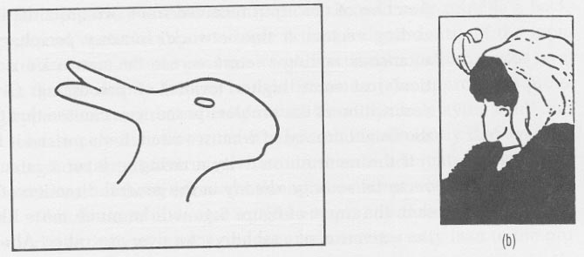
Hopfield Nets in the Brain??
The cerebral cortex is full of recurrent connections, and there is solid evidence for Hebbian synapse modification there. Hence, the cerebrum is believed to function as an associative memory.
Flip-flop figures indicate distributed hopfield-type coding, since we cannot hold both perceptions simultaneously (binding problem)

Slide 22
Things to Remember
Auto-Associative -vs- Hetero-associative
  Wide variety of net topologies
  All use Hebbian Learning => weights ~ avg correlations
One-shot -vs- Iterative Retrieval
  Iterative gives much better error correction.
Asynchronous -vs- Synchronous state updates
  Synchronous updates can easily lead to oscillation
  Asynchronous updates can quickly find a local optima (attractor)
    Update order can determine attractor that is reached.
Pattern Retrieval = Search in node-state space.
  Spurious patterns are hard to avoid, since many are attractors also.
  Stochasticity helps jiggle out of local minima.
  Memory load increase => recall error increase.
Associative -vs- Feed-Forward Nets
  Assoc: Many - 1 mapping Feed-Forward: many-many mapping
  Backprop is resource-intensive, while Hopfield iterative update is O(n)
  Gradient-Descent on an Error -vs- Energy Landscape:
    Backprop => arc-weight space Hopfield => node-state space

Slide 23
Deep Learning
Notes:
Not memtion
DT v.s. Deep!!!!!

Slide 24
Deep Learning
Learning deep (many layered) neural networks
The more layers in a Neural Network, the more abstract features can be represented
E.g. Classify a cat:
  Bottom Layers: Edge detectors, curves, corners straight lines
  Middle Layers: Fur patterns, eyes, ears
  Higher Layers: Body, head, legs
  Top Layer: Cat or Dog

Slide 25
Deep Learning
Real world information has a hierarchical structure, cannot easily be modeled by a neural network with 3 layers
The human brain is a deep neural network, has many layers of neurons which acts as feature detectors, detecting more and more abstract features as you go up

Slide 26
Deep Learning
Traditional approach is to use back propagation to train multiple layers
However back propagation does not work well over multiple layers and does not scale well
Back propagation cannot leverage unlabelled data
Recent advances in deep learning attempt to address this short-comings

Slide 27
Deep-Learning is Typically –
1. Layer-wise, bottom-up pre-training of unsupervised neural networks (auto-encoders, RBM’s)
2. Supervised training on labeled data using either:
    i) Features learned from 1. fed into a classifier
    e.g. SVM
    ii) An additional output layer is placed on top to form a feed forward network, which is then trained using back prop on labeled data

Slide 28
Why? –
Achieved State of the Art in a Number of Different Areas
Language Modeling (2012, Mikolov et al)
Image Recognition (Krizhevsky won 2012 ImageNet competition)
Sentiment Classification (2011, Socher et al)
Speech Recognition (2010, Dahl et al)
MNIST hand-written digit recognition (Ciresan et al, 2010)
Andrew Ng – Machine Learning Professor, Stanford:
  “I’ve worked all my life in Machine Learning, and I’ve never seen one algorithm knock over benchmarks like Deep Learning”

Slide 29
Application Areas
Typically applied to image and speech recognition, and NLP
Each are non-linear classification problems where the inputs are highly hierarchal in nature (language, images, etc)
The world has a hierarchical structure – Jeff Hawkins – On Intelligence
Problems that humans excel in and machine do very poorly

Slide 30
Deep vs Shallow Networks
Given the same number of non-linear (neural network) units, a deep architecture is more expressive than a shallow one (Bishop 1995)
Two layer (plus input layer) neural networks have been shown to be able to approximate any function
However, functions compactly represented in k layers may require exponential size when expressed in 2 layers

Slide 31
Deep Network
Shallow Network
Shallow (2 layer) networks need a lot more hidden layer nodes to compensate for lack of expressivity
In a deep network, high levels can express combinations between features learned at lower levels
Notes:
Analogy – nodes as features

Slide 32
Traditional Supervised Machine Learning Approach
For each new problem:
  Gather as much LABELED data as you can get \ handle
  Throw a bunch of algorithms at it (after trying RF \ SVM .. insert favorite algo here)
  Pick the best
  Spend hours hand engineering some features \ doing feature selection \ dimensionality reduction (PCA, SVD, etc)
  RINSE AND REPEAT…..

Slide 33
Unsupervised Training
Far more un-labeled data in the world (i.e. online) than labeled data:
  Websites
  Books
  Videos
  Pictures
Deep networks take advantage of unlabelled data by learning good representations of the data through unsupervised learning
Humans learn initially from unlabelled examples
Babies learn to talk without labeled data

Slide 34
Unsupervised Feature Learning
Learning features that represent the data allows them to be used to train a supervised classifier
As the features are learned in an unsupervised way from a different and larger dataset, less risk of over-fitting
No need for manual feature engineering
  (e.g. Kaggle Salary Prediction contest)
Latent features are learned that attempt to explain the data

Slide 35
Unsupervised Learning - Distributed Representations
Approaches to unsupervised learning of features fall into two categories:
  Local Representations (hard clustering)
  Distributed Representations (soft \ fuzzy clustering)
Hard clustering approaches (e.g. k-means, DBSCAN) - learn to map a set of data points to individual clusters
Fuzzy clustering, dimensionality reduction approaches (SVD, PCA), topic modeling (LDA) and unsupervised feature learning with neural networks learn distributed representations
Assumes that the data can be explained by the interaction of many different unobserved factors
Unseen configurations of these factors can more effectively explain unseen data
Much fewer features needed to describe the space as they can be combined in many different ways

Slide 36
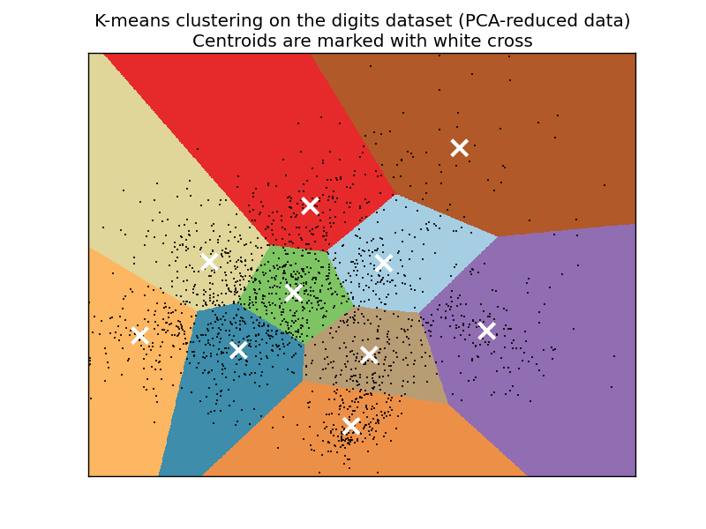
Local Representation

Slide 37
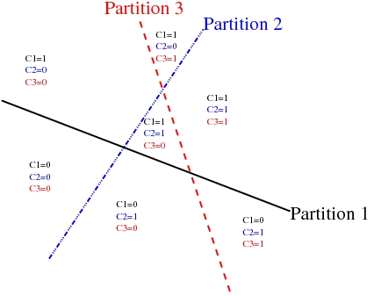
Distributed Representation

Slide 38
Hierarchical Representations
These factors are organized into multiple levels
Each level creates new features from combinations of features from the level below
Each level is more abstract than the ones below
Hierarchies of distributed representations attempt to solve the “Curse of Dimensionality” by learning the underlying latent variables that cause the variability in the data

Slide 39
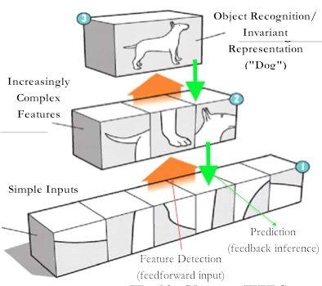
Hierarchical Representations

Slide 40
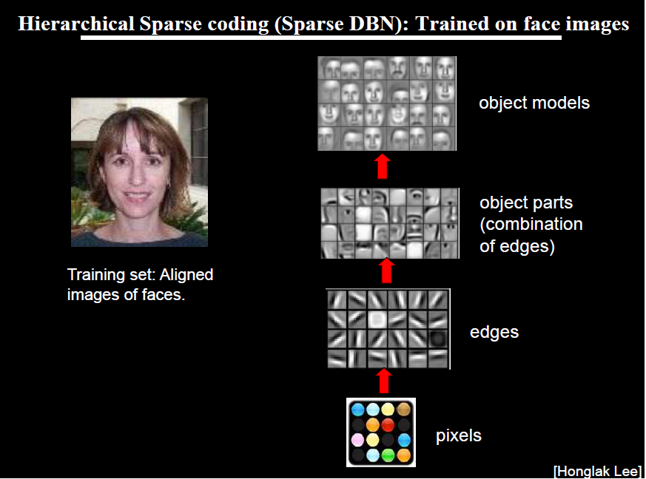
Notes:
From “Machine Learning and AI for Brain Simulations” – Andrew Ng Talk, UCLA, 2012
Visualization of weights at different layers of three layer deep neural networks trained on pictures of faces, cars, elephants and chairs
This is proof, for me at least, that we are doing something really special here

Slide 41
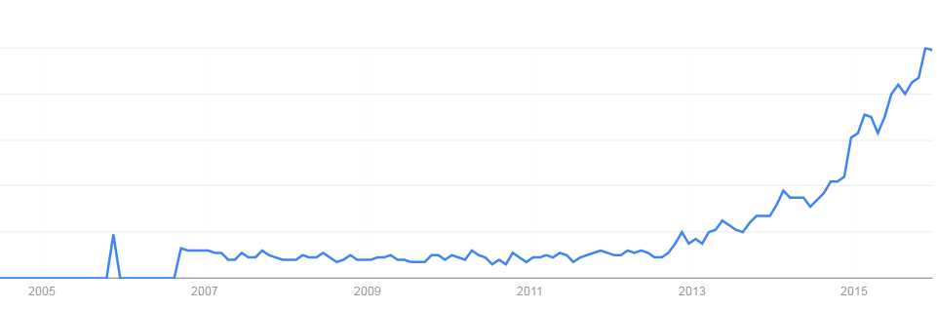
Deep learning attracts lots of attention.
Google Trends
Deep learning obtains many exciting results.
The talks in this afternoon
This talk will focus on the technical part.
2007
2009
2011
2013
2015

Slide 42
Three questions:
Model
Cost
Train
What people already knew in 1980s
Notes:
Three questions:
Model
Cost
Train

Slide 43
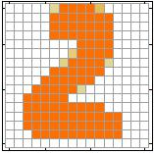
Example Application
Handwriting Digit Recognition
Machine
“2”
Notes:
“Hello world” for deep learning
Data: http://yann.lecun.com/exdb/mnist/

Slide 44
Handwriting Digit Recognition
Input
Output
y₁
is 1
0.1
y₂
is 2
0.7
The image is “2”
……
……
……
y₁₀
0.2
is 0
16 x 16 = 256
Ink → 1
No ink → 0
Each dimension represents the confidence of a digit.
Notes:
The same for even more complex tasks.

Slide 45
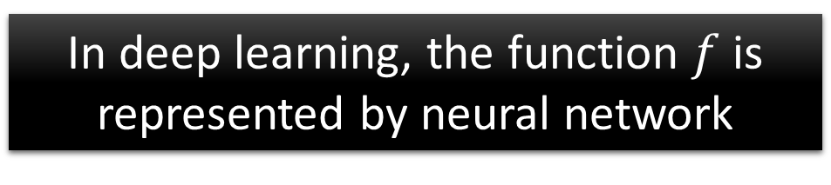

Example Application
Handwriting Digit Recognition
y₁
Machine
y₂
“2”
……
……
y₁₀
$$f:R^{256}→R^{10}$$
In deep learning, the function $f$ is represented by neural network

Slide 46

Element of Neural Network
Neuron
$$f:R^{K}→R$$
…
Activation function
weights
bias
Notes:
sigmoid

Slide 47
Neural Network
neuron
Input
Layer 1
Layer 2
Layer L
Output
……
y₁
……
y₂
……
……
……
……
……
……
y_{M}
Input Layer
Output Layer
Hidden Layers
Deep means many hidden layers
Notes:
Fully Connected Feedforward Network
You can always connect the neurons in your own way.
“+” is ignored
Each dimension corresponds to a digit (10 dimension is needed)

Slide 48
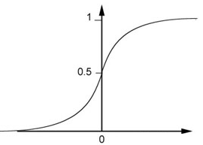
Example of Neural Network
1
4
0.98
1
-2
1
-1
-2
0.12
-1
1
0
Sigmoid Function
Notes:
Ignore +

Slide 49
Example of Neural Network
1
4
0.98
2
0.86
3
0.62
1
-2
-1
-1
1
0
-2
-1
-2
0.12
-2
0.11
-1
0.83
-1
1
-1
4
0
0
2

Slide 50
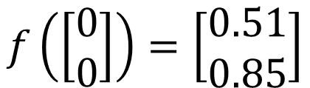

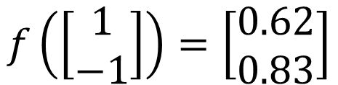
Example of Neural Network
1
0.73
2
0.72
3
0.51
0
-2
-1
-1
1
0
-2
-1
0.5
-2
0.12
-1
0.85
0
1
-1
4
0
0
2
$$f:R^{2}→R^{2}$$
$$f\left(\left[\begin{matrix}1 \\ −1\end{matrix}\right]\right)=\left[\begin{matrix}0.62 \\ 0.83\end{matrix}\right]$$
$$f\left(\left[\begin{matrix}0 \\ 0\end{matrix}\right]\right)=\left[\begin{matrix}0.51 \\ 0.85\end{matrix}\right]$$
Different parameters define different function
Notes:
For example, if we modify “1” to “2”, then we have another function

Slide 51
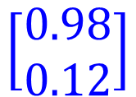


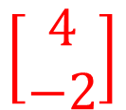

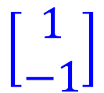

Matrix Operation
1
4
0.98
1
-2
1
-1
-2
0.12
-1
1
0
$$\left[\begin{matrix}1 & −2 \\ −1 & 1\end{matrix}\right]$$
$$\left[\begin{matrix}1 \\ −1\end{matrix}\right]$$
$$\left[\begin{matrix}1 \\ 0\end{matrix}\right]$$
$$=$$
$$\left[\begin{matrix}0.98 \\ 0.12\end{matrix}\right]$$
$$σ\left( \right)$$
$$+$$
$$\left[\begin{matrix}4 \\ −2\end{matrix}\right]$$
Notes:
Make sure you know how to do it
author: Adam Coates, Baidu, Inc.
Deep Learning (hopefully faster)
http://videolectures.net/deeplearning2015_coates_deep_learning/

Slide 52



Neural Network
……
y₁
W¹
W²
W^{L}
……
y₂
b¹
b²
b^{L}
……
……
……
……
……
x
a¹
a²
y
……
y_{M}
W¹
x
b¹
+
$$σ\left( \right)$$
a¹
b²
W²
+
$$σ\left( \right)$$
W^{L}
b^{L}
a^{L-1}
+
$$σ\left( \right)$$
Notes:
Draw it?

Slide 53


Neural Network
……
y₁
W¹
W²
W^{L}
……
y₂
b¹
b²
b^{L}
……
……
……
……
……
x
a¹
a²
y
……
y_{M}
y
x
Using parallel computing techniques to speed up matrix operation
$$=f\left( \right)$$
W^{L}
…
W²
W¹
x
b¹
b²
…
b^{L}
+
+
+
$$σ\left( \right)$$
$$=σ\left( \right)$$
$$σ\left( \right)$$
x
Notes:
Draw it?

Slide 54
Softmax
Softmax layer as the output layer
Ordinary Layer
In general, the output of network can be any value.
May not be easy to interpret
Notes:
Original output layer is local

Slide 55
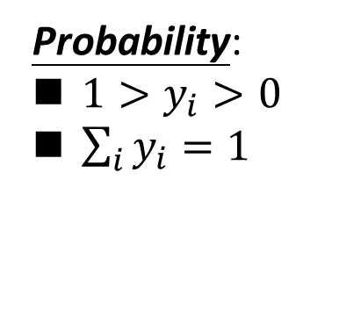
Softmax
Probability:
$1>y_{i}>0$
$\sum_{i}{y_{i}=1}$
Softmax layer as the output layer
Softmax Layer
3
20
0.88
1
2.7
0.12
-3
0.05
≈0
Notes:
Why it is name soft max?
Monotonicity of softmax
Non-locality of softmax

Slide 56


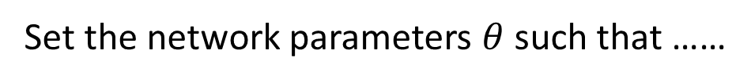
How to set network parameters
$$θ=\left\{W^{1},b^{1},W^{2},b^{2},⋯W^{L},b^{L}\right\}$$
……
y₁
is 1
0.1
……
y₂
0.7
is 2
Softmax
……
……
……
……
y₁₀
is 0
0.2
16 x 16 = 256
Ink → 1
No ink → 0
Set the network parameters $θ$ such that ……
Input:
How to let the neural network achieve this
y₁ has the maximum value
Input:
y₂ has the maximum value

Slide 57








Training Data
Preparing training data: images and their labels
“5”
“0”
“4”
“1”
“9”
“2”
“1”
“3”
Using the training data to find the network parameters.

Slide 58

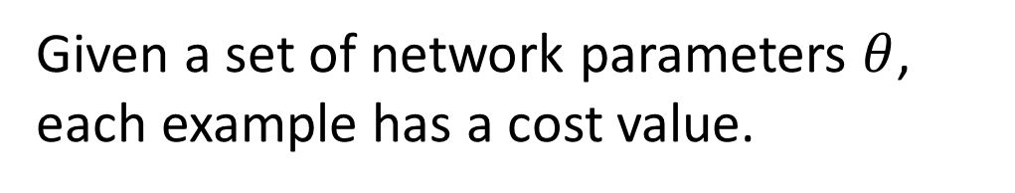
Cost
Given a set of network parameters $θ$, each example has a cost value.
“1”
……
y₁
0.2
1
……
y₂
0
0.3
……
……
……
Cost
……
……
……
y₁₀
$$L(θ)$$
0
0.5
target
Cost can be Euclidean distance or cross entropy of the network output and target
Notes:
With softmax, the summation of all the ouputs would be one.
Can be considered as probability if you want ……

Slide 59
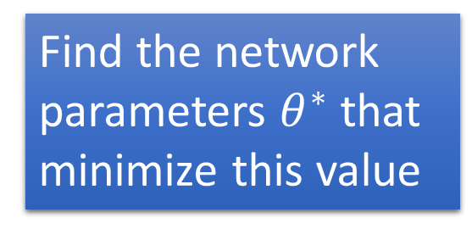


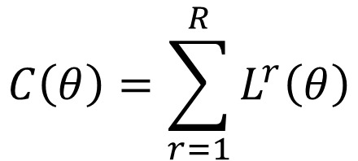






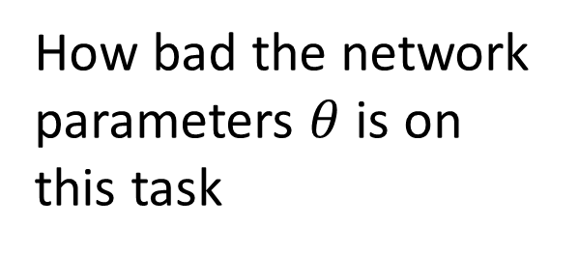
Total Cost
For all training data …
Total Cost:
NN
$$C\left(θ\right)=\sum_{r=1}^{R}{L^{r}\left(θ\right)}$$
x¹
y¹
$${\hat{y}}^{1}$$
$$L^{1}\left(θ\right)$$
x²
NN
y²
$${\hat{y}}^{2}$$
How bad the network parameters $θ$ is on this task
$$L^{2}\left(θ\right)$$
x³
NN
y³
$${\hat{y}}^{3}$$
$$L^{3}\left(θ\right)$$
……
……
……
……
Find the network parameters $θ^{∗}$ that minimize this value
x^{R}
NN
y^{R}
$${\hat{y}}^{R}$$
$$L^{R}\left(θ\right)$$
Notes:
Randomly picked one
Two approaches update the parameters towards the same direction, but stochastic is faster!
Better!

Slide 60
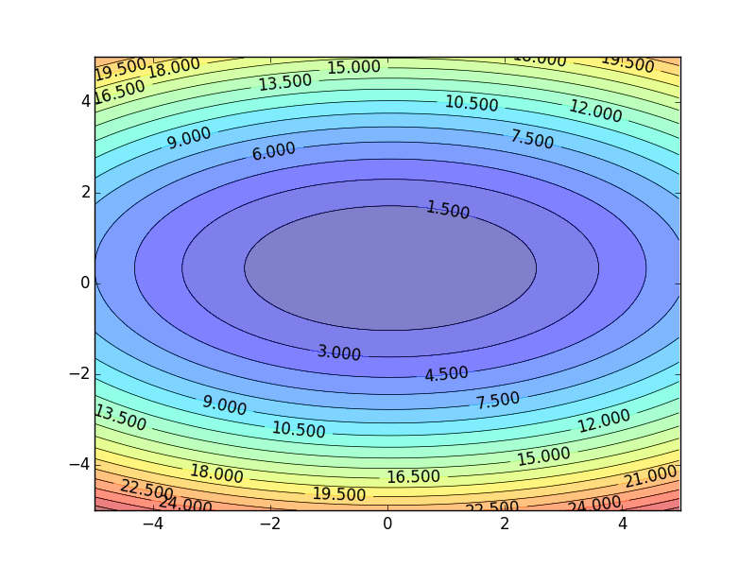
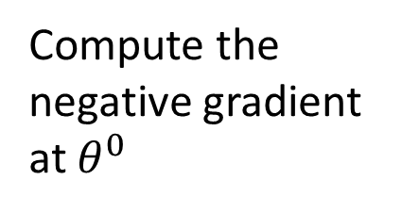

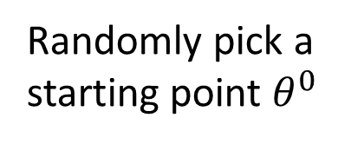
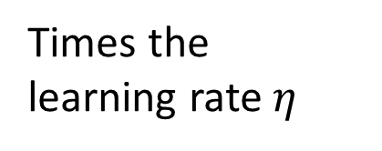








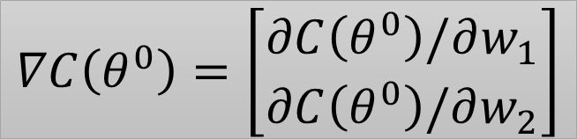
Gradient Descent
Assume there are only two parameters w₁ and w₂ in a network.
Error Surface
$$θ=\left\{w_{1},w_{2}\right\}$$
The colors represent the value of C.
Randomly pick a starting point $θ^{0}$
Compute the negative gradient at $θ^{0}$
$$w_{2}$$
$$θ^{∗}$$
$$−η∇C\left(θ^{0}\right)$$
$$−∇C\left(θ^{0}\right)$$
$$−∇C\left(θ^{0}\right)$$
Times the learning rate $η$
$$∇C\left(θ^{0}\right)=\left[\begin{matrix}∂C\left(θ^{0}\right)/∂w_{1} \\ ∂C\left(θ^{0}\right)/∂w_{2}\end{matrix}\right]$$
$$θ^{0}$$
$$−η∇C\left(θ^{0}\right)$$
$$w_{1}$$
Notes:
Eta
人站在 ｔｈｅｔａ０ 環顧四周 看看哪裡最低，那個方向就是 ｇｒａｄｉｅｎｔ

Slide 61






Gradient Descent
Eventually, we would reach a minima …..
Randomly pick a starting point $θ^{0}$
Compute the negative gradient at $θ^{0}$
$$θ^{2}$$
$$−η∇C\left(θ^{2}\right)$$
$$−η∇C\left(θ^{1}\right)$$
$$w_{2}$$
$$−∇C\left(θ^{2}\right)$$
$$−∇C\left(θ^{1}\right)$$
$$θ^{1}$$
$$−∇C\left(θ^{0}\right)$$
Times the learning rate $η$
$$θ^{0}$$
$$−η∇C\left(θ^{0}\right)$$
$$w_{1}$$

Slide 62
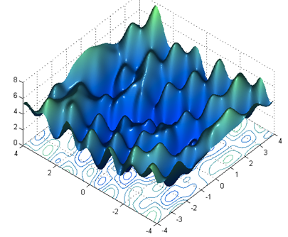

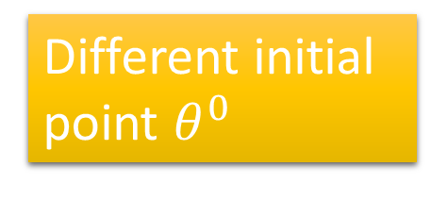


Local Minima
Gradient descent never guarantee global minima
Different initial point $θ^{0}$
Reach different minima, so different results
$$C$$
  Who is Afraid of Non-Convex Loss Functions?
  http://videolectures.net/eml07_lecun_wia/
$$w_{1}$$
$$w_{2}$$

Slide 63



Besides local minima ……
cost
Very slow at the plateau
Stuck at saddle point
Stuck at local minima
$$∇C\left(θ\right)≈0$$
$$∇C\left(θ\right)=0$$
$$∇C\left(θ\right)=0$$
parameter space

Slide 64
In physical world ……
Momentum
How about put this phenomenon in gradient descent?
Notes:
Momentum: 動量

Slide 65
Momentum
Still not guarantee reaching global minima, but give some hope ……
cost
Movement =
Negative of Gradient + Momentum
Negative of Gradient
Momentum
Real Movement
Gradient = 0
Notes:
What can we see?

Slide 66









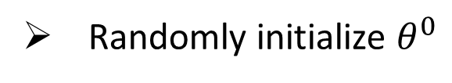



Mini-batch
Randomly initialize $θ^{0}$
x¹
NN
y¹
Pick the 1st batch
$${\hat{y}}^{1}$$
$$L^{1}$$
$$C=L^{1}+L^{31}+⋯$$
Mini-batch
NN
x³¹
y³¹
$${\hat{y}}^{31}$$
$$θ^{1}←θ^{0}−η∇C\left(θ^{0}\right)$$
$$L^{31}$$
Pick the 2nd batch
……
$$C=L^{2}+L^{16}+⋯$$
NN
$$θ^{2}←θ^{1}−η∇C\left(θ^{1}\right)$$
x²
y²
$${\hat{y}}^{2}$$
$$L^{2}$$
…
Mini-batch
C is different each time when we update parameters!
x¹⁶
NN
y¹⁶
$${\hat{y}}^{16}$$
$$L^{16}$$
……
Notes:
Each time we update paramters, we have different target -> 不安
Shuffle data, and repeat above process

Slide 67
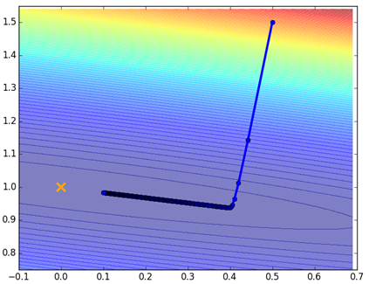
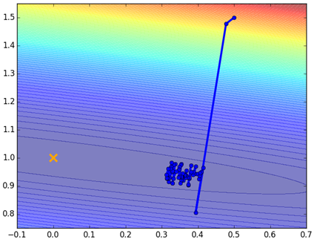
Mini-batch
Original Gradient Descent
With Mini-batch
unstable
The colors represent the total C on all training data.
Notes:
Hopefully, when the match size is large enough,
Not that stateble

Slide 68






Mini-batch
Faster
Better!
Randomly initialize $θ^{0}$
x¹
NN
y¹
Pick the 1st batch
$${\hat{y}}^{1}$$
$$C^{1}$$
$$C=C^{1}+C^{31}+⋯$$
Mini-batch
NN
x³¹
y³¹
$${\hat{y}}^{31}$$
$$θ^{1}←θ^{0}−η∇C\left(θ^{0}\right)$$
$$C^{31}$$
Pick the 2nd batch
……
$$C=C^{2}+C^{16}+⋯$$
NN
$$θ^{2}←θ^{1}−η∇C\left(θ^{1}\right)$$
x²
y²
$${\hat{y}}^{2}$$
$$C^{2}$$
…
Until all mini-batches have been picked
Mini-batch
x¹⁶
NN
y¹⁶
$${\hat{y}}^{16}$$
$$C^{16}$$
one epoch
……
Repeat the above process
Notes:
Ｉｎ ｏｐｅｎ ｅｐｏｃｈ， ｕｐｄａｔｅ ｍａｎｙ ｔｉｍｅｓ
Shuffle data, and repeat above process

Slide 69



Backpropagation
A network can have millions of parameters.
  Backpropagation is the way to compute the gradients efficiently (not today)
  Ref: http://speech.ee.ntu.edu.tw/~tlkagk/courses/MLDS_2015_2/Lecture/DNN%20backprop.ecm.mp4/index.html
Many toolkits can compute the gradients automatically
Ref: http://speech.ee.ntu.edu.tw/~tlkagk/courses/MLDS_2015_2/Lecture/Theano%20DNN.ecm.mp4/index.html
Notes:
Just a function

Slide 70
Part II:
Why Deep?

Slide 71
Deeper is Better?
Layer X Size | Word Error Rate (%) | Layer X Size | Word Error Rate (%)
1 X 2k | 24.2
2 X 2k | 20.4
3 X 2k | 18.4
4 X 2k | 17.8
5 X 2k | 17.2 | 1 X 3772 | 22.5
7 X 2k | 17.1 | 1 X 4634 | 22.6
 |  | 1 X 16k | 22.1
Not surprised, more parameters, better performance
Seide, Frank, Gang Li, and Dong Yu. "Conversational Speech Transcription Using Context-Dependent Deep Neural Networks." Interspeech. 2011.
Notes:
SWB
For a fixed number of parameters, a deep model is clearly better than the shallow one.

Slide 72
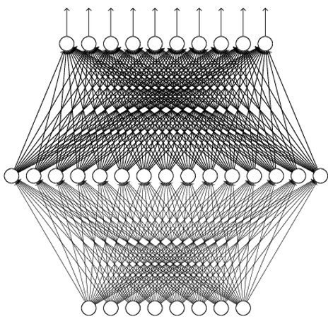
Universality Theorem
Any continuous function f
Can be realized by a network with one hidden layer
(given enough hidden neurons)
Reference for the reason: http://neuralnetworksanddeeplearning.com/chap4.html
Why “Deep” neural network not “Fat” neural network?

Slide 73
Fat + Short v.s. Thin + Tall
The same number of parameters
Which one is better?
……
……
……
Shallow
Deep

Slide 74
Fat + Short v.s. Thin + Tall
Layer X Size | Word Error Rate (%) | Layer X Size | Word Error Rate (%)
1 X 2k | 24.2
2 X 2k | 20.4
3 X 2k | 18.4
4 X 2k | 17.8
5 X 2k | 17.2 | 1 X 3772 | 22.5
7 X 2k | 17.1 | 1 X 4634 | 22.6
 |  | 1 X 16k | 22.1
Seide, Frank, Gang Li, and Dong Yu. "Conversational Speech Transcription Using Context-Dependent Deep Neural Networks." Interspeech. 2011.

Slide 75
Why Deep?
can be trained by little data
Deep → Modularization
Classifier 1
Girls with
long hair
Boy or Girl?
Classifier 2
Boys with
long hair
Image
Basic
Classifier
fine
Little data
Classifier 3
Girls with
short hair
Long or short?
Classifier 4
Boys with short hair
Sharing by the following classifiers as module

Slide 76
Why Deep?
Deep Learning also works on small data set like TIMIT.
→ Less training data?
Deep → Modularization
……
The modularization is automatically learned from data.
……
……
……
……
……
……
The most basic classifiers
Use 1st layer as module to build classifiers
Use 2nd layer as module ……
Notes:
Need less data!!!!!

Slide 77
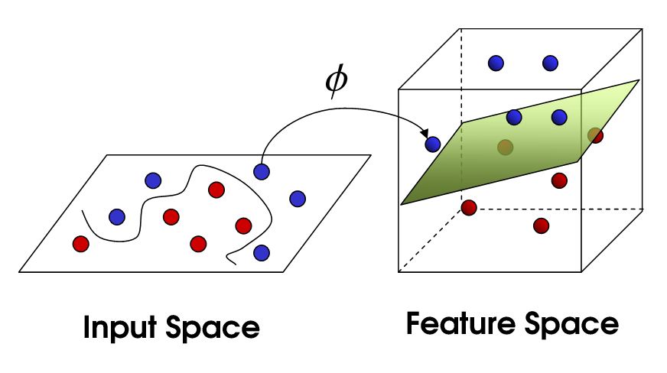


Hand-crafted
kernel function
SVM
Apply simple classifier
Source of image: http://www.gipsa-lab.grenoble-inp.fr/transfert/seminaire/455_Kadri2013Gipsa-lab.pdf
Deep Learning
simple classifier
Learnable kernel
$$φ\left(x\right)$$
……
y₁
$$x$$
……
y₂
…
…
…
…
…
……
y_{M}

Slide 78
Part III:
Tips for Training DNN
Notes:
The techniques people did not know in 1980s.

Slide 79
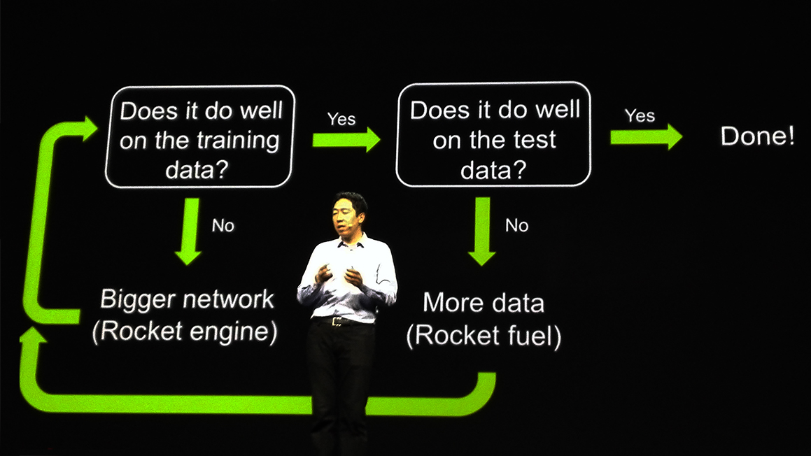
Recipe for Learning
http://www.gizmodo.com.au/2015/04/the-basic-recipe-for-machine-learning-explained-in-a-single-powerpoint-slide/
Notes:
今年四月的 GTC

Slide 80
Recipe for Learning
Don’t forget!
overfitting
Modify the Network
Preventing
Overfitting
Better optimization Strategy
http://www.gizmodo.com.au/2015/04/the-basic-recipe-for-machine-learning-explained-in-a-single-powerpoint-slide/
Notes:
Last one is on training set
Sometimes students ask

Slide 81
Recipe for Learning
Modify the Network
Better optimization Strategy
Prevent Overfitting
New activation functions, for example, ReLU or Maxout
Adaptive learning rates
Dropout
Only use this approach when you already obtained good results on the training data.

Slide 82
Part III:
Tips for Training DNN
New Activation Function

Slide 83





ReLU
Rectified Linear Unit (ReLU)
Reason:
$$a$$
$$σ\left(z\right)$$
1. Fast to compute
$$a=z$$
2. Biological reason
$$a=0$$
3. Infinite sigmoid with different biases
$$z$$
4. Vanishing gradient problem
[Xavier Glorot, AISTATS’11]
[Andrew L. Maas, ICML’13]
[Kaiming He, arXiv’15]
Notes:
Parametric ReLU, -> PReLU
Ref: Glorot, Xavier, Antoine Bordes, and Yoshua Bengio. "Deep sparse rectifier neural networks." International Conference on Artificial Intelligence and Statistics. 2011.
No differentailalbe how about 0
Benefit:
2011
Where does it come from?
fast to compute
biology?
many sigmoid

Slide 84
Vanishing Gradient Problem
……
y₁
In 2006, people used RBM pre-training.
In 2015, people use ReLU.
……
y₂
……
……
……
……
……
……
y_{M}
Smaller gradients
Larger gradients
Learn very slow
Learn very fast
Almost random
Already converge
based on random!?
Notes:
The problem of gradient vanish is very hard to explain ……………….!!!!!!!!!!!!!!!!!!!!!!!!!!!!!!!!!
See Gradient flow in recurrent nets: the difficulty of learning long-term dependencies, by Sepp Hochreiter, Yoshua Bengio, Paolo Frasconi, and Jürgen Schmidhuber (2001). This paper studied recurrent neural nets, but the essential phenomenon is the same as in the feedforward networks we are studying. See also Sepp Hochreiter's earlier Diploma Thesis,Untersuchungen zu dynamischen neuronalen Netzen (1991, in German).
Stuck at a bad local minima
When deep learning is difficult in early year
Need initialization
Another point of view
Definition of gradient

Slide 85
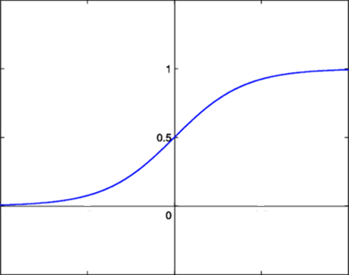



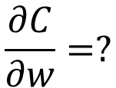






Vanishing Gradient Problem
Smaller gradients
……
$$y_{1}$$
$${\hat{y}}_{1}$$
Small output
……
$$y_{2}$$
$${\hat{y}}_{2}$$
……
……
……
……
……
$$C$$
……
$$+∆C$$
……
$$y_{M}$$
$${\hat{y}}_{M}$$
Large input
$$+∆w$$
Intuitive way to compute the gradient …
$$\frac{∂C}{∂w}=?$$
$$\frac{∆C}{∆w}$$

Slide 86
ReLU
$$a$$
$$a=z$$
$$a=0$$
$$z$$
0
0
0
0

Slide 87
ReLU
$$a$$
$$a=z$$
A Thinner linear network
$$a=0$$
$$z$$
Do not have smaller gradients

Slide 88












Maxout
ReLU is a special cases of Maxout
Learnable activation function [Ian J. Goodfellow, ICML’13]
+
neuron
+
$$5$$
$$1$$
Input
Max
$$7$$
Max
$$2$$
+
$$7$$
+
$$2$$
+
$$−1$$
+
$$4$$
Max
$$1$$
Max
$$4$$
+
$$1$$
+
$$3$$
You can have more than 2 elements in a group.
Notes:
How to train? Latter
2013
Ian J. Goodfellow goodfeli@iro.umontreal.ca David Warde-Farley wardefar@iro.umontreal.ca Mehdi Mirza mirzamom@iro.umontreal.ca Aaron Courville aaron.courville@umontreal.ca Yoshua Bengio

Slide 89
Maxout
ReLU is a special cases of Maxout
Learnable activation function [Ian J. Goodfellow, ICML’13]
  Activation function in maxout network can be any piecewise linear convex function
  How many pieces depending on how many elements in a group
2 elements in a group
3 elements in a group
Notes:
3,4,5

Slide 90
Part III:
Tips for Training DNN
Adaptive Learning Rate

Slide 91




Learning Rate
Set the learning rate η carefully
$$−η∇C\left(θ^{0}\right)$$
If learning rate is too large
Cost may not decrease after each update
$$w_{2}$$
$$−∇C\left(θ^{0}\right)$$
$$θ^{0}$$
$$w_{1}$$

Slide 92

Learning Rate
Can we give different parameters different learning rates?
Set the learning rate η carefully
If learning rate is too large
Cost may not decrease after each update
$$w_{2}$$
If learning rate is too small
$$−∇C\left(θ^{0}\right)$$
$$−η∇C\left(θ^{0}\right)$$
$$θ^{0}$$
Training would be too slow
$$w_{1}$$

Slide 93


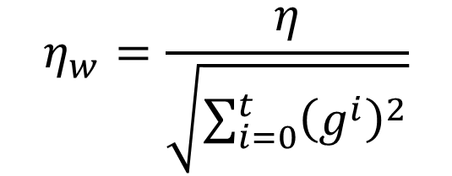
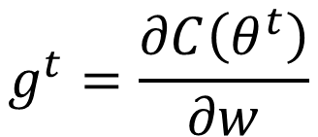
Adagrad
Original Gradient Descent
$$θ^{t}←θ^{t−1}−η∇C\left(θ^{t−1}\right)$$
Each parameter w are considered separately
$$g^{t}=\frac{∂C\left(θ^{t}\right)}{∂w}$$
$$w^{t+1}←w^{t}−{\text{η}}_{w}g^{t}$$
Parameter dependent learning rate
constant
$${\text{η}}_{w}=\frac{η}{\sqrt{\sum_{i=0}^{t}{{\left(g^{i}\right)}^{2}}}}$$
Summation of the square of the previous derivatives

Slide 94
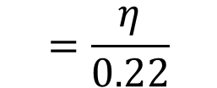

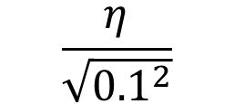
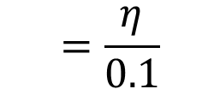

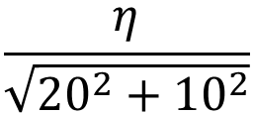
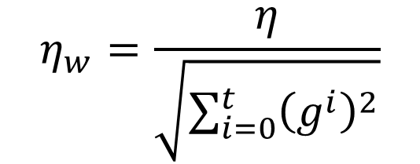
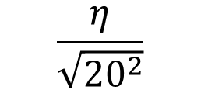
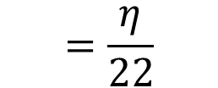
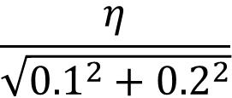
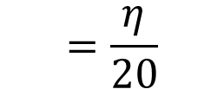
Adagrad
$${\text{η}}_{w}=\frac{η}{\sqrt{\sum_{i=0}^{t}{{\left(g^{i}\right)}^{2}}}}$$
g⁰ | g¹ | ……
0.1 | 0.2 | ……
g⁰ | g¹ | ……
20.0 | 10.0 | ……
$$w_{1}$$
$$w_{2}$$
Learning rate:
Learning rate:
$$\frac{η}{\sqrt{{0.1}^{2}}}$$
$$=\frac{η}{0.1}$$
$$\frac{η}{\sqrt{{20}^{2}}}$$
$$=\frac{η}{20}$$
$$\frac{η}{\sqrt{{0.1}^{2}+{0.2}^{2}}}$$
$$=\frac{η}{0.22}$$
$$\frac{η}{\sqrt{{20}^{2}+{10}^{2}}}$$
$$=\frac{η}{22}$$
Observation:
1. Learning rate is smaller and smaller for all parameters
2. Smaller derivatives, larger learning rate, and vice versa
Why?
Notes:
反差
http://seed.ucsd.edu/mediawiki/images/6/6a/Adagrad.pdf
http://courses.cs.washington.edu/courses/cse547/15sp/slides/adagrad.pdf

Slide 95
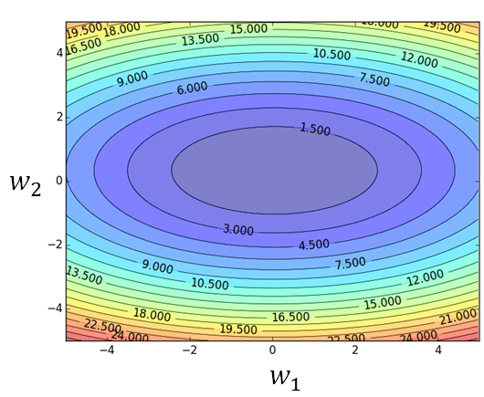
Larger derivatives
Smaller Learning Rate
Smaller Derivatives
Larger Learning Rate
2. Smaller derivatives, larger learning rate, and vice versa
Why?

Slide 96
Not the whole story ……
Adagrad [John Duchi, JMLR’11]
RMSprop
  https://www.youtube.com/watch?v=O3sxAc4hxZU
Adadelta [Matthew D. Zeiler, arXiv’12]
Adam [Diederik P. Kingma, ICLR’15]
AdaSecant [Caglar Gulcehre, arXiv’14]
“No more pesky learning rates” [Tom Schaul, arXiv’12]
Notes:
Ada delta: http://www.matthewzeiler.com/pubs/googleTR2012/googleTR2012.pdf
Adam: http://arxiv.org/pdf/1412.6980.pdf
AdaSecant
http://arxiv.org/pdf/1412.7419v4.pdf
“No more pesky learning rates”
http://arxiv.org/pdf/1206.1106.pdf
Adasecodn: Yoshua Bengio
No learning rate: Yann LeCun
SECANT: sec (not mentioned)
http://arxiv.org/pdf/1412.7419v4.pdf

Slide 97
Part III:
Tips for Training DNN
Dropout

Slide 98

Dropout
Pick a mini-batch
$$θ^{t}←θ^{t−1}−η∇C\left(θ^{t−1}\right)$$
Training:
Each time before computing the gradients
Each neuron has p% to dropout
Notes:
Iteration v.s. epoch!!!!!!!!

Slide 99
Dropout
Pick a mini-batch
$$θ^{t}←θ^{t−1}−η∇C\left(θ^{t−1}\right)$$
Training:
Thinner!
Each time before computing the gradients
Each neuron has p% to dropout
The structure of the network is changed.
Using the new network for training
For each mini-batch, we resample the dropout neurons
Notes:
Do not worry that someone will not update

Slide 100

Dropout
Testing:
No dropout
If the dropout rate at training is p%, all the weights times (1-p)%
Assume that the dropout rate is 50%.
If a weight $w=1$ by training, set $w=0.5$ for testing.
Notes:
Bias do not have to multiply !!!!!!!!!!!!!!!!!!!!!!!!!!!!!!!!!!!
Reasonable !!!!!!!!!!!!!!!!!!!!

Slide 101
Dropout - Intuitive Reason
Partner
When teams up, if everyone expect the partner will do the work, nothing will be done finally.
However, if you know your partner will dropout, you will do better.
When testing, no one dropout actually, so obtaining good results eventually.
Notes:
Why the weights should multiply p (dropout rate) at testing?

Slide 102
















Dropout - Intuitive Reason
Why the weights should multiply (1-p)% (dropout rate) when testing?
Training of Dropout
Testing of Dropout
Assume dropout rate is 50%
No dropout
Weights from training
$$w_{1}$$
$$0.5×$$
$$w_{1}$$
$$z^{′}≈2z$$
$$w_{2}$$
$$z$$
$$0.5×$$
$$w_{2}$$
$$z^{′}$$
$$w_{3}$$
$$0.5×$$
$$w_{3}$$
$$w_{4}$$
$$0.5×$$
$$w_{4}$$
Weights multiply (1-p)%
$$z^{′}≈z$$
Notes:
important

Slide 103
Dropout is a kind of ensemble.
Training Set
Ensemble
Set 1
Set 2
Set 3
Set 4
Network
1
Network
2
Network
3
Network
4
Train a bunch of networks with different structures

Slide 104
Dropout is a kind of ensemble.
Ensemble
Testing data x
Network
1
Network
2
Network
3
Network
4
y₁
y₂
y₃
y₄
average

Slide 105
Dropout is a kind of ensemble.
minibatch
1
minibatch
2
minibatch
3
minibatch
4
Training of Dropout
M neurons
……
2^{M} possible networks
Using one mini-batch to train one network
Some parameters in the network are shared

Slide 106
Dropout is a kind of ensemble.
Testing of Dropout
testing data x
All the weights multiply (1-p)%
……
y₁
y₂
y₃
average
≈
y
Notes:
0,0 -> 0
1,0 -> 1
0,-1 -> -2
1,-1 -> -1
½, -1/2 -> -0.5
1,2
Geometric Mean?

Slide 107
More about dropout
    More reference for dropout [Nitish Srivastava, JMLR’14] [Pierre Baldi, NIPS’13][Geoffrey E. Hinton, arXiv’12]
    Dropout works better with Maxout [Ian J. Goodfellow, ICML’13]
    Dropconnect [Li Wan, ICML’13]
      Dropout delete neurons
      Dropconnect deletes the connection between neurons
    Annealed dropout [S.J. Rennie, SLT’14]
      Dropout rate decreases by epochs
    Standout [J. Ba, NISP’13]
      Each neural has different dropout rate

Slide 108
Part IV:
Neural Network with Memory
Notes:
Not just process, but memory

Slide 109
Neural Network needs Memory
Name Entity Recognition
  Detecting named entities like name of people, locations, organization, etc. in a sentence.
1
DNN
0.1
people
apple
0
…
0.1
location
0
0.5
organization
0.3
none
0

Slide 110
Neural Network needs Memory
Name Entity Recognition
  Detecting named entities like name of people, locations, organization, etc. in a sentence.
target
ORG
target
NONE
y¹
y²
y³
y⁴
y⁵
y⁶
y⁷
DNN
DNN
DNN
DNN
DNN
DNN
DNN
x¹
x²
x³
x⁴
x⁵
x⁶
x⁷
the president of apple eats an apple
DNN needs memory!
Notes:
DNN: input and output are both vector

Slide 111
Recurrent Neural Network (RNN)
The output of hidden layer are stored in the memory.
copy
Memory can be considered as another input.

Slide 112
RNN
y¹
y²
y³
Wº
copy
Wº
copy
Wº
a¹
a²
a³
a¹
a²
W^{h}
W^{h}
W^{i}
W^{i}
W^{i}
x¹
x²
x³
The same network is used again and again.
Output y^{i} depends on x¹, x², …… x^{i}
Notes:
General idea

Slide 113



RNN
How to train?
$${\hat{y}}^{1}$$
target
$${\hat{y}}^{2}$$
target
$${\hat{y}}^{3}$$
target
L¹
L²
L³
y¹
y²
y³
Wº
Wº
Wº
W^{h}
W^{h}
……
W^{i}
W^{i}
W^{i}
x¹
x²
x³
Find the network parameters to minimize the total cost:
Backpropagation through time (BPTT)
Notes:
General idea

Slide 114
Of course it can be deep …
y^{t}
y^{t+1}
y^{t+2}
……
……
……
……
……
……
……
……
……
x^{t}
x^{t+1}
x^{t+2}

Slide 115
Bidirectional RNN
……
x^{t}
x^{t+1}
x^{t+2}
……
y^{t}
y^{t+1}
y^{t+2}
……
……
x^{t}
x^{t+1}
x^{t+2}
Notes:
To determine yi, you have to consider a lot ……
You should see the whole sequence

Slide 116
Matrix Operation
1
4
0.98
1
-2
1
-1
-2
0.12
1
-1
0
W
x
b
a
$$\left[\begin{matrix}1 & −2 \\ −1 & 1\end{matrix}\right]$$
$$\left[\begin{matrix}1 \\ −1\end{matrix}\right]$$
$$\left[\begin{matrix}1 \\ 0\end{matrix}\right]$$
$$=$$
$$\left[\begin{matrix}0.98 \\ 0.12\end{matrix}\right]$$
$$σ\left( \right)$$
$$+$$
Notes:
Make sure you know how to do it
author: Adam Coates, Baidu, Inc.
Deep Learning (hopefully faster)
http://videolectures.net/deeplearning2015_coates_deep_learning/

Slide 117
Disadvantages of Deep Learning
Steep learning curve
Some problems more amenable to deep learning than other applications
Simpler models may be sufficient for certain problem domains
Regression models?
Unless you are working with images, the models are very hard to explain (compared with a decision tree)
  What does neuron 524 do?

Slide 118
Useful Deep Learning Links
Deeplearning.Net:
  Code, tutorials, papers
  http://deeplearning.net/
Theano (Cuda + Python also):
  Comprehensive tutorials
  Symbolic programming (like SymPy) can be a little confusing
  http://deeplearning.net/software/theano/
Toronto groups’ code (Cuda + Python):
  Easier to understand than Theano
  https://github.com/nitishsrivastava/deepnet
www.socher.org
  All of Richard Socher’s research papers and code (mainly Matlab, some java)
  Links to his tutorials on YouTube on Deep Learning and NLP
The SENNA system developed by Collobert and Weston
  http://ronan.collobert.com/senna/
  A pretty complete NLP system (for download) that uses Deep Learning to perform NER, POS tagging, parsing, chunking and SRL
  Contains the word embeddings file so you can use their word embeddings in your own work

